Slide 1
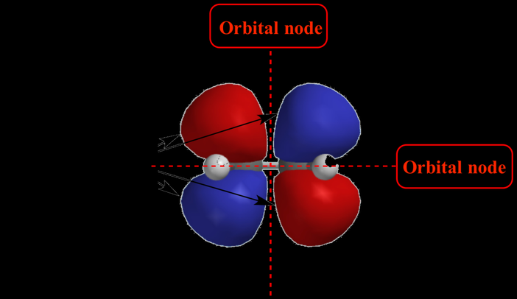
Shapes of Atomic orbitals
BS Chemistry 2019
Semester II

Slide 2
s-orbitals
The s-orbitals are solid spherical shape around the nucleus.
When principal quantum number n = 1 and azimuthal quantum number l = 0, that is 1s orbital which is closest to the nucleus.
When n = 2 and l = 0 , i.e 2s orbital which contains one node.
When n = 3 and l = 0, i.e 3s orbital which contains two nodes.
So we can say that the s orbitals are always spherical regardless of the principal quantum number, regardless of size, regardless of the number of nodes they contain.
The pictorial representation of these orbitals are shown below:

Slide 3
s-orbital

Slide 4
p-orbitals
The p-orbitals are dumb-bell shape contains two lobes just like two identical balloons tied together.
The two lobes stay away from each other along the axial line.
When n = 1, there are no p-orbitals, it has only s-orbital.
When n = 2 and l = 1, the magnetic quantum number m = +1, 0, -1.
Thus three dumb-bell shape p-orbitals are found pointing towards the three axes x, y and z which are perpendicular to each other.
These three orbitals are named as px, py and pz.
The nodal plane is the plane where there are no possibility of finding any electrons.
The nodal planes of px, py, pz are yz, xz and xy respectively.

Slide 5
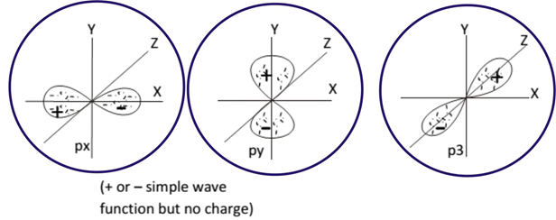

Slide 6
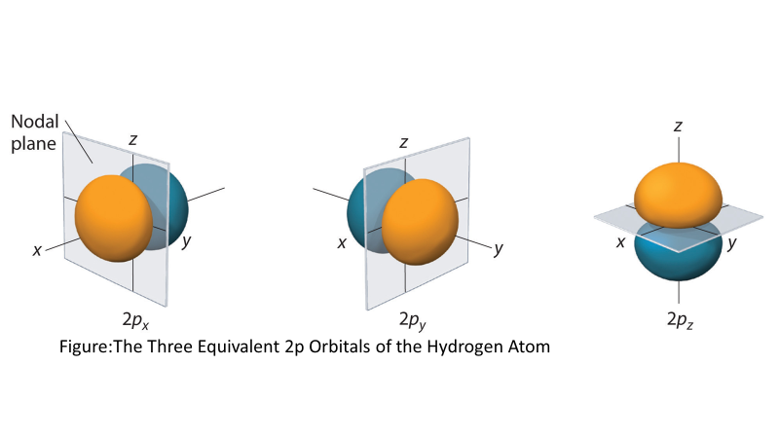

Slide 7
d-orbitals
The d-orbitals have different shapes and these are only available when
principal quantum number n = 3 or more.
When n = 3, l = 2, then m = +2, +1, 0, +1 and +2.
That means five d-orbitals are available in an atom.
The directions, names and the shapes of these orbitals are as follows:

Slide 8
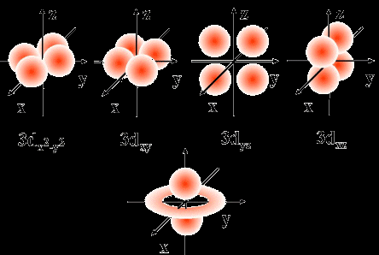
d-orbitals

Slide 9
d-orbitals

Slide 10
Electron distribution in orbitals
s-orbitals
Number of maximum electrons that each s-orbital can hold is two regardless of the number of principal quantum number (n).
Such as 1s², 2s², 3s² etc. We need to recall that the spin of these two electrons must be opposite.
p-orbitals
Each p sub-orbital can posses maximum of two electrons each that means six for all three p- orbitals.
We can write that either 2p⁶ or 2p_{x}² 2p_{y}² 2p_{z}². The spin of each of these orbitals must be opposite.
d and f-orbitals
The total number of electrons in d sub-orbitals and f-orbitals are ten and fourteen respectively.
Here maximum two electrons can occupy in each of these d or f sub-orbitals.

Slide 11
Spin quantum number
Spin of these two electrons in each orbitals will be always in opposite direction.
This image shows the maximum electron distribution in each orbitals:

